Slide 1
Drug Policy Impact Assessment – the Perspective of People Who Use Drugs (PWUD)
It should be possible to obey the law if you use drugs (PWUD should be allowed to carry daily supply of drugs
  F. ex. 1g of heroin in Kyrgyzstan)
PWUD should be protected from police abuse and enjoy right to fair trial – the same as other people
  F. ex. in Kyrgyzstan police often plants some more heroin on you – to make it more than 1g

Slide 2
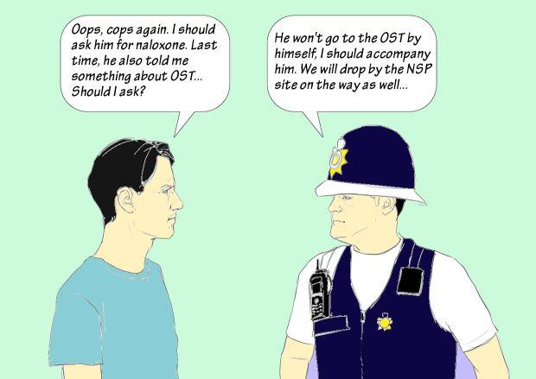
This is how effective drug policy looks like

Slide 3
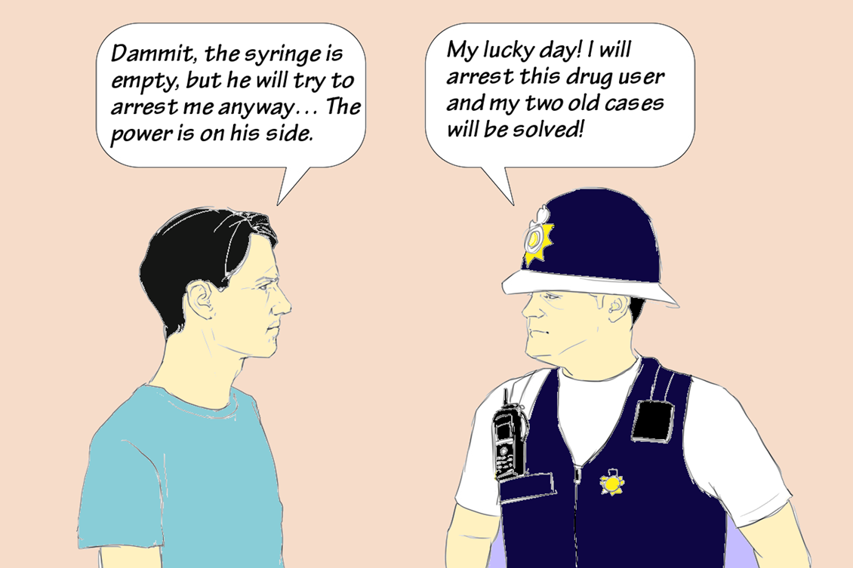
This is what we face today

Slide 4
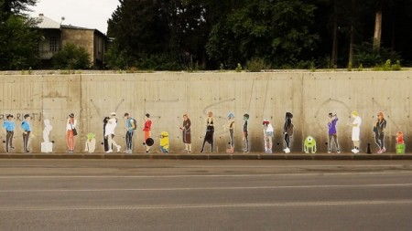
HUMAN RIGHTS
URINE DRUG TESTING

Slide 5
Repressive Drug Policy in Georgia
2009: Zero tolerance policy and intensified war on drugs
For example: for the consumption of Extasy – 450$ + 6 months of imprisonment
Results:
  Heroine and cocaine were displaced by new home-made drugs (based on pharmaceuticals)
  Massive incarceration of PWUD for drug use
  Street drug testing – anyone could be stopped by police and forced to perform a drug test

Slide 6
Drug Policy Impact on Our Lives and RIghts
When the government did not protect PWUD, civil society started to do it
2014: the first case when a person refused to undergo street drug testing – got huge social media coverage
A public campaign “42nd Article of the Constitution” started
In one year 30% of people refused to undergo street drug testing
Police tortured people to make them obey

Slide 7
Article 42
Georgian Constitution
A suspect has a right not to testify against themselves (to
undergo urine, blood, DNA tests)
12 hours in police station
No phone calls
No using toilet
Pressure to be recruited as police ‘agent’
Beating up
Diuretics
Torture

Slide 8
«Balanced Drug Policy» in Georgia today
Impact on Police:
  Police is interested in high rates of drug use crimes: for 1 positive urine test that get a monetary bonus
Impact on PWUD:
  Abuse and torture
  Economic costs – one fine for drug use is an average monthly wage
  For the possession of 0.00009 desomorphine (=traces in a used syringe) - 8 years imprisonment
  For possession of 2 LSD doses – a fine equal to the price of 2 bedroom apartment & 3 years of probation

Slide 9
Results of Zero Tolerance Approach
For 3,000,000 population total in Georgia:
→ 40,000 of registered PWUD
2016 → 55.000 of registered PWUD

Slide 10
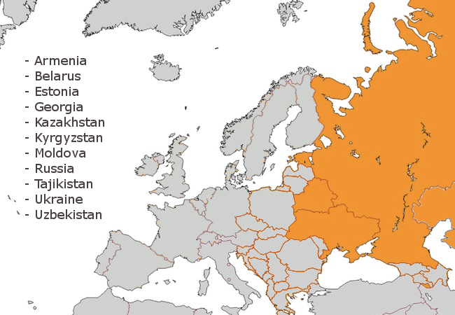

Regional project by EHRN and ENPUD with the support of IDPC as lead of International Consortium

